Slide 1
Design Patterns

Slide 2
Design Patterns
A design pattern is
A general repeatable solution to a commonly occurring problem in software design
A design pattern isn't a finished design that can be transformed directly into code
A description or template for how to solve a problem that can be used in many different situations

Slide 3
Importance of Design Patterns
Design patterns can speed up the development process by providing tested, proven development paradigms
Reusing the design patterns helps to prevent subtle issues that can cause major problems and it also improves code readability
Design pattern provides general solutions, documented in a format that doesn’t specifically tied to a particular problem
In addition to that patterns allows developers to communicate well-known, well-understood names for software interactions
Common design patterns can be improved over time, making them more robust than ad-hoc design
A standard solution to a common programming problem enables large scale reuse of software

Slide 4
Classification of Design Patterns
Can be classified into three types
Creational design patterns
Structural design patterns
Behavioural design patterns

Slide 5
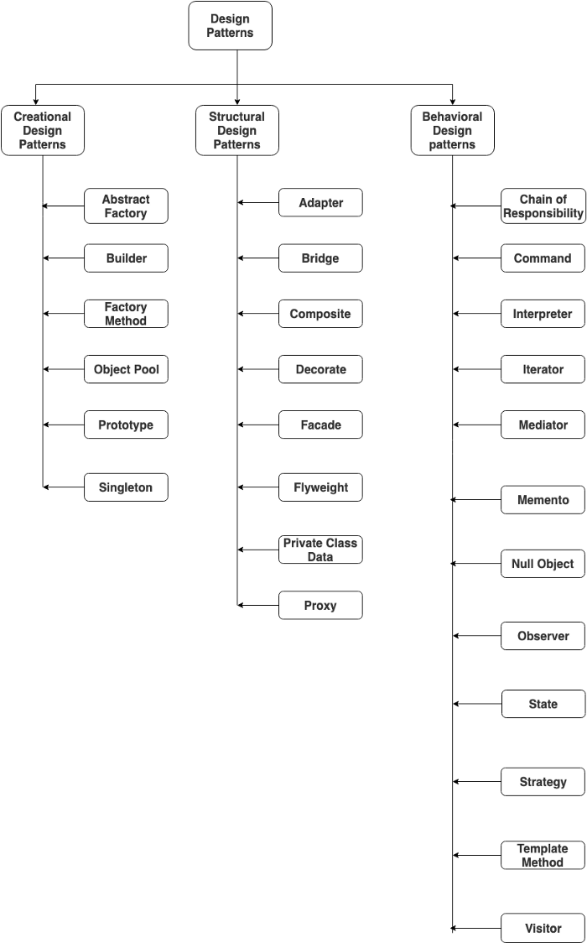
Classification of Design Patterns

Slide 6
Creational design patterns
Are concerned with the way of creating objects
Can be further divided into
Class-creation patterns
Use inheritance effectively in the instantiation process
Object-creation patterns
Use delegation effectively to get the job done

Slide 7
Structural Design Patterns
Are concerned with how classes and objects can be composed to form larger structures
Simplify the structure by identifying relationships
Focus on how the classes inherit from each other and how they are composed of other classes
Use inheritance to compose interfaces
Define ways to compose objects to obtain new functionality

Slide 8
Behavioral Design Patterns
Are concerned with the interaction and responsibility of objects
The interaction between the objects should be in such a way that they can easily communicate with each other and still should be loosely coupled

Slide 9
Iterator Design Patterns
Iterator design pattern is used
To access and traverse an aggregate object without exposing its internal structure
To provide a way to access the elements of an aggregate object sequentially without exposing its underlying representation

Slide 10
Iterator Design Patterns
Problem
Need to access the elements of an aggregate object without exposing the internal details of object
Accessing elements of object is required with traversal, without exposing the internal structure of aggregate object
Should be applicable to different data structures which provide different algorithms for accessing and traversing
Solution
Provide a way to access and traverse an aggregate object by giving responsibility of access and traversal to another object
There can be common interface, which can be applicable for different data structures to provide interface for accessing and traversing
There will be separate objects having this interface and will have responsibility to access the elements and traversal of aggregate objects

Slide 11
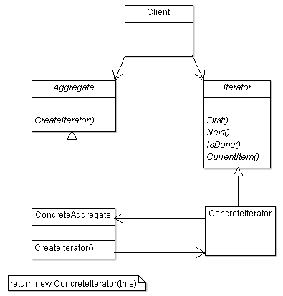
Structure
Participant classes
Aggregate class
Provides the interface for creating
Iterator object
Iterator class
Provides the interface for accessing
the elements and traversal of the
aggregate object
ConcreteIterator class
Implements the interface of Iterator
class and keeps track of current item
of aggregate object
ConcreteAggregate class
Implements the method
CreateIterator()

Slide 12
Working
the Client class refers to
The Aggregate interface for creating an Iterator object (createIterator())
The Iterator interface for traversing an Aggregate object
The ConcreteIterator class implements the Iterator interface by accessing the ConcreteAggregate class
The run-time interactions
The Client object calls createIterator() on an ConcreteAggregate object which creates an ConcreteIterator object and returns it to the Client
The Client uses then ConcreteIterator to traverse the elements of the Aggregate object

Slide 13
Model View Controller Design Pattern (MVC)
Model View Controller is
A predictable software design pattern that can be used across many frameworks with many programming languages
Used to design web applications and mobile apps

Slide 14
Architecture :: Model View Controller
The architecture components of the MVC pattern are designed
To handle different aspects of an application in development
The MVC design pattern serves
To separate the presentation layer from the business logic

Slide 15
Architecture :: Model View Controller
The architecture components of the MVC pattern are designed
To handle different aspects of an application in development
The MVC design pattern serves
To separate the presentation layer from the business logic

Slide 16
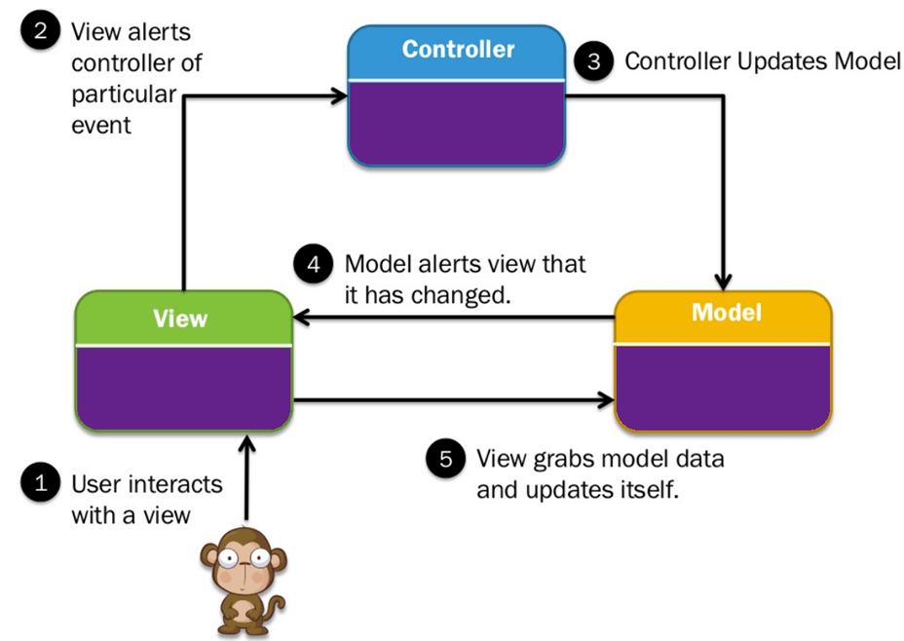
Architecture :: Model View Controller
Separates an application into three main logical components
Model
stores & manages data
Often a database
View
Graphical User Interface
A visual representation of the
data like a chart, diagram, form
contains all functionality that directly interacts with the user
Controller
Brains of the application
Connects the model and view
Receives input from view, uses logic to translate the input to a demand for the model, the model grabs the data, the controller passes data from the model back to the view for the user to see in a nice display

Slide 17
Benefits :: Model View Controller Pattern
Traditionally used for Graphical user interfaces (GUIs)
Popular in web applications
MVC responsibilities are divided between the client & server, compatible with web application architecture
Helpful for planning development
The code is divided based on function to either the model, view, or controller bucket
Loosely Coupled
Removes unnecessary dependencies
Reusable without modification
Code reuse
Extendable code
High Cohesion

Slide 18
Command Design Pattern
Command Design Pattern
Is an Object behavioural design pattern that decouples sender and receiver by encapsulating a request as an object
Thereby letting clients to be parameterized with different requests and support undoable operations
Command Design Pattern
Encapsulates all the requests coming from the invoker in objects, passing them to the receiver, and letting the receiver take actions
Command Design pattern can be used
To produce readable, maintainable, and extensible code
Widely used in sophisticated software

Slide 19
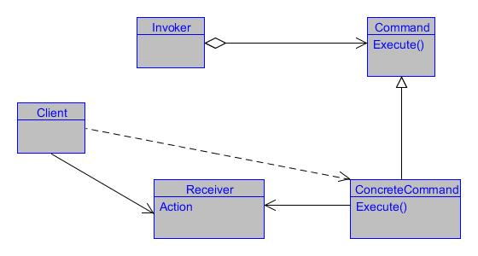
Command Design Pattern
Client: Creates a ConcreteCommand object and sets its receiver
Invoker: Uses the Command object to carry out the request
Receiver: Contains the real operational logic that needs to be performed on the data
Command: An interface for executing an action
ConcreteCommand: Specifies the binding between a Receiver (action taker) and an action invoker. This object is responsible for executing the corresponding operation on the Receiver

Slide 20
Benefits of Command Design Pattern
Command Pattern is
A very good way of decreasing the coupling between the sender and receiver
While implementing the Command design pattern
The Command is just a link between the sender and receiver
Only tells the receiver what the sender is expecting
Never alters the logic of the sender and receiver in any way
Command pattern encapsulates request
Thereby it can be used to record state, implement Undo and redo functionality, Queuing a request, etc.
Command Pattern
Makes it easy to add new commands.
New functionality is added by creating a new code

